Slide 1

Writing your research proposal
Part 1: The task
(Start slideshow to hear the audio for this presentation)

Slide 2
The breakdown
The maximum page count is 6 pages, not including references, Gannt chart, or risk analysis.
Executive Summary | approx. 0.5 page
Introduction/Motivation | approx. 1.5 page
Literature Review/Technical Background/Competitor Analysis | approx. 3 pages
Proposed Approach/Methodology/Research Questions | approx. 1 page
Bibliography/Reference List | approx. 1 page
Gannt Chart of Project Plan | approx. 1 page
Risk Analysis | approx. 1 page

Slide 3
The marking scale 1 of 2
Explain Motivation: | idea, niche, story, goals: feasible-interesting-novel-ethical-relevant (FINER)
Specify Hypothesis: | scientific, precise, concise, focussed, testable
Identify Requirements: | elicitation, definition, prioritisation, scope
Define Objectives: | added value: specific-measurable-achievable-realistic-timed
Survey Background: | contextual/technical, breadth/depth, data/tools, competitors/resources

Slide 4
The marking scale 2 of 2
Plan Project: | timeline: tasks-deliverables-milestones, risks: mitigation-contingency
Suggest Methodology | (blend of) Type-I-II-III, waterfall vs. agile, strategy
Propose Evaluation: | qualitative, quantitative, users, experts, stakeholders
Preliminary Conclusions: | contribution, reflection, significance, limitations, continuation
Effectively Communicate: | language, formatting, structure, flow, prioritisation, attribution
Show Independence: | challenge, originality, autonomy, balance, evolution

Slide 5
Writing your research proposal
Part 2: The marking criteria

Slide 6
How to score 60-64
Project assessment criteria are satisfied to a good standard with few areas of weakness. Good knowledge and understanding Clear evidence of analysis, coherence ability to synthesise materials from other modules, primary sources and knowledge at the forefront of the field. Report well organised, accurate and very well presented (with “all the boxes being ticked”).

Slide 7
How to score 65-69
Project assessment criteria satisfied to high standard with very few areas of weakness. Excellent knowledge and understanding clear evidence of analysis, coherence, creativity, originality ability to synthesise appropriate principles by reference, where appropriate, to primary sources and knowledge at the forefront of the field. Report very well organised, accurate and very well presented some aspect of excellence.

Slide 8
How to score 75-79
Project assessment criteria satisfied to high standard with no areas of weakness. Very extensive knowledge with impressive conceptual understanding. Extensive evidence of analysis, coherence, creativity, originality, autonomy, imagination Ability to deal with complexity, contradictions or gaps in the knowledge base Ability to synthesise appropriate principles by reference to primary sources and knowledge at the forefront of the field. Report very well organised, accurate, very well presented Exemplary of what MSc students should be aiming to achieve.

Slide 9
Writing your research proposal
Part 3: Analysis of samples

Slide 10
Sample 1 (distinction)
The project is beautifully written with a clear motivation, a thorough related work and a clear plan of actions and deliverables. The project is well placed in the literature. This would be a great candidate to send to a peer reviewed conference. Well done!

Slide 11
Parkinson’s is ………………..., with an estimated prevalence ………………………. [2]. It is characterised by …………….. Non-motor symptoms include ………………..[2]. Parkinson’s disease, alongside …………….., have recently become the focus of newly developed VR experiences [3–5] either as part of treatment, training and education, or for spreading awareness.
As VR technology has developed, it has been increasingly explored as a tool for eliciting empathy. This motivation is supported by …………….., which reported that ……………………[6]. A large-scale study also supports ……………..[7]. Simulation of disability has also been investigated as a tool for e…………… [8], whilst wearable simulation devices have also ………….. [9]. There are ethical concerns associated with using simulations………such as………… [10], or inaccurate representation [11]. For use in VR, this project aims to incorporate …………………………. to improve ……………….., such as showing examples of …………………. to overcome ………………………….. [11].
Haptic technology has also seen developments over the years, particularly ………………………….[12]. Recent research suggests……..
Alongside its capabilities as a tool for empathy, VR has also been explored for use in training and education. These experiences can be described as ‘Serious Games’ where gameplay elements are introduced as a means of improving the capability for learning during educative sessions [16]. These Serious Games ……….
This project proposes a pilot study where ………………………, providing insight into the potential relationship between ……………………………. and …………………in an interactive ……………….. simulation. Our research output can inform future decisions made by developers considering …………………………… as tool for the production of …………………….. In particular, for those interested in ………………………, the benefits observed for user experience can be balanced against the …………………….
The term ‘Exergaming’ has been used to describe ………………………... These are now being investigated for …………………….. [3]. One study has focused on…………. [3].A recent study into …………………… suggests that …………. could help to ……………… and inform ………….. [9].
In the previously mentioned study investigating……………….[3], interviews with participants revealed that ………………… [3]. Previously, disability simulations ………………… [8]. Considering these findings, the development of an interactive VR experience that mirrors elements of the condition could provide …….…………………….
This research proposal outlines the development of ………………….which will deliver an interactive experience, using haptics to simulate ……………………. The main aim of our research is to explore whether the integration of …………. will result in increased ……………., greater ………………. and improved …………………, in comparison to ……….. The target demographic for our developed product will be ………….. We aim to provide ……………… which elicits ……….. in users and provides an effective medium for ………………………..
As it is a symptomatically heterogeneous disease, people with Parkinson’s …………. [2]. Consequently, the proposed VR system would not accurately represent the exact experience of a single person with the condition. However, the design and development of the experience will be informed by …………... These will discuss common symptoms, the more pertinent issues, and how these might be integrated into VR in order to build a more universal representation.

Slide 12
There is a very well thought plan with 7 steps to lead to the conclusion of the project. All the steps are well descried and make sense altogether.

Slide 13
PROPOSED APPROACH
Research Questions
Can ……………….? Does ……………..? Will …………..?
Design and Development
Development will be based on …………………that will involve working on ……………….. (See Gant Chart). Initial designs will be …………….. organised with …………, then followed by ……………… (See Fig 1).
Software and Hardware
……………. will be the …………….. chosen, due to ……………………. The latest version of ……….. will be chosen as ……………….., as it allows ………………, which is compatible with ………….. [1]. An interactive experience will be produced in ………, some training is expected to be provided during ………………….
…………… will be available for use as a ………. Materials will also be provided by the University of Bristol Faculty of Engineering. ………….. will be able to offer support incorporating ……………. The Merchant Ventures Building ‘Hackspace’ workshop will be available for engineering purposes. The design of ……………………. can be informed by existing devices that are built for a similar purpose, for example ………………… [29].
Evaluation
The pilot prototype will be user tested in ………………………….(See Gant Chart). To test our hypothesis, we will perform quantitative and qualitative evaluation. …………… will be included to obtain qualitative reactions ………………., in terms of ……………. We also hope to engage ……………with the pilot prototype to gauge how effectively………………….
Measuring ……………
………………… adapted to use a seven-point Likert Scale, in order to be able to quantify and compare ……………….. These questions will be modelled similarly to questions available from previous studies …………………. [4], [28].
Measuring …………….
…………………. for evaluating …………….. will also be provided, which will be based on ……………………..[33]
Measuring ……………….
Following ……………..,, a set of common scenarios and symptoms will be described during……………….. Participants be asked to ………………………… The number of ………………….. can be compared ……………..
Limitations
……………. will only be able to reflect ………………., however it is outside the scope of the current project to ……………….. ………………. can also be problematic due to …………….. Presence can be measured through …………….[21], however this current study is unlikely to ……………..

Slide 14
Sample 2 (distinction)
The project is very well-motivated. The related work is well done. This project can have relevant and impactful implications.
The different steps learning (sic) to the implementation (hardware and software) of the proposed system are well described, as well as the evaluation and analysis of the results.

Slide 15
PROPOSED APPROACH
The project aims at addressing the following question: ………………………….. ?
A user-centric approach will be adopted in the design and development process of the project, where the user (the beneficiary) participates in the majority of the project phases. The project development goes through six phases. These phases are Requirements gathering and definition, Specification, Design, Implementation, Integration and Test, and Evaluation, as shown in Figure 2. Each of these phases has a number of associated stages, tasks, and practices. A brief description of each phase is as follows.
• Requirements gathering and definition: obtaining …………………… and organizing the information that has been gathered. The requirements will be captured ………………………..
• Requirements specification: writing an accurate set of instructions which………………. This could include …………….. and the output feedback by the system to both groups.
• Design: in this phase, the structure of the system is established and designed to meet the requirements identified in the previous phase. The requirements are translated into ……………………. This document used as ………………………… The basic components of the proposed system and its functions will be …………………………….
• Implementation: translating higher-level designs into appropriate coding and corresponding hardware/software tools. These include ……………..: Scenario 1: ………………….. Scenario 2: …………………. Scenario 3: ……………………..
• Integration and deployment: installing………………………….
• Testing and Evaluation: testing the system on a group representing real users through ………………… The components of the system are tested by ……………... The testing process is divided into two sub tests……………………….. The data gathered from both approaches are considered for ……………….
The above explained phases are implemented in an Iterative model. The iterative process ………………………...
An iterative life cycle model does not attempt to start with ………………. Instead, ………………... This process is then repeated, ………………. [34]. The main contribution of this project will be ………………..It aims at facilitating ………………………...

Slide 16
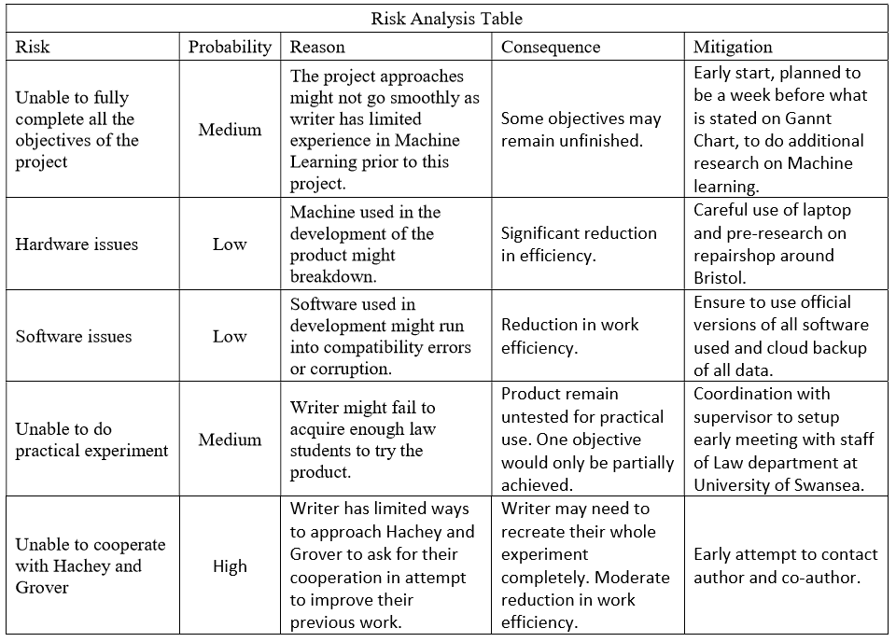
Sample 3 (distinction)
‘Risk analysis is of a very high standard’

Slide 17
Writing your research proposal
Part 4: Common issues

Slide 18
Common issues
- On one hand, the objectives and so requirements of the project are fairly clear……………However, there is much less detail re. how each of those objectives breaks down, and so concrete requirements for them.
it's therefore hard to see how the result will be evaluated: it's unclear, for example, how to measure objective 1: "working" vs. "not working", because what that actually means is potentially so broad.

Slide 19
- In my view the risk analysis is quite terse, and overly rote. Most of the entries are too generic, and not enough attention is paid to project-specific risks; examples include non-availability of a data set or environment in which to test and evaluate the system, which seems to be ignored throughout. The plan, i.e., Gantt chart, is similar: the tasks seem to lack detail, up to the point that there are no design or evaluation elements (both of which seem crucial, yet non-trivial).

Slide 20
Research proposal: common issues
‘I didn't see it explicitly mentioned, and it's quite hard to judge the project type: I'd *guess* some mixture of Type I (software development) and Type II (investigatory)?’
‘the major issue is an argument the content is presented at at too high a level in places, in the sense there's too little (low level) technical detail. Even obvious devices, such as use of a proposed system architecture or flow chart, which could act to clarify some questions, are missing.’
‘On one hand, the objectives and so requirements of the project are fairly clear: page 1 gives a high level overview. However, there is much less detail re. how each of those objectives breaks down, and so concrete requirements for them. In my view it's therefore hard to see how the result will be evaluated: it's unclear, for example, how to measure objective 1 even wrt. "working" vs. "not working", because what that actually means is potentially so broad.’

Slide 21
Research proposal: Common issues
‘alternatives to Logisim already exist: there is no mention, let alone comparison with them’
‘it is unclear what the student aims to achieve or exactly how. For example, it is stated that test will be conducted to see if the chosen solution comply with GDPR. Has any thought been invested in designing those tests?’

Slide 22
Summary
Write clearly and precisely (what, how, why)
Place your work within the literature
Consider and analyse project specific risks
Deal with the complexity, contradictions and gaps in the literature
Display creativity, originality, autonomy and imagination

